Slide 1

DEEPFAKE DETECTION
NAME : RAJIVMENAN A
ROLL NO: 222DA012
PROJECT TITLE : DEEPFAKE DETECTION USING DEEP LEARNING
GUIDED BY : Mrs. S. SHENBAHA., M.Sc., M.Tech., (Ph.D).,
CLASS : M.Sc COMPUTER SCIENCE WITH DATA ANALYTICS
Dr. N.G.P. ASC
Coimbatore, Tamil Nadu, India

Slide 2

COMPANY PROFILE
COMPANY NAME : VENPEP SOLUTION
LOCATION : COIMBATORE
WEBSITE : VenPep | Software Development | IT Solutions Company | MarTech
Dr. N.G.P. ASC
Coimbatore, Tamil Nadu, India

Slide 3
PROBLEM STATEMENT
To Design and Develop a Deep Learning algorithm to classify the video as deepfake or pristine.
Algorithmic Sophistication: Deepfake algorithms are becoming more sophisticated.
Data Variability: Deepfake content varies in facial expressions, lighting, and quality.
Real-time Detection: Detection system needs to operate in real-time.
Generalization Across Media: Deepfakes can manifest in images, videos, and audio.
Adversarial Attacks: Adversarial techniques pose a challenge for detection systems.
Dr. N.G.P. ASC
Coimbatore, Tamil Nadu, India

Slide 4
SYNOPSIS
Introduction
Pre-processing
01
04
System Architecture
Training Workflow
02
05
Dataset Exploration
Prediction Workflow
03
06
Dr. N.G.P. ASC
Coimbatore, Tamil Nadu, India

Slide 5

INTRODUCTION
Deep fake is a technique for human image synthesis based on artificial intelligence.
Deep fakes are created by combing and superimposing existing images and videos onto source images or videos using a deep learning technique known as generative adversarial network.
Dr. N.G.P. ASC
Coimbatore, Tamil Nadu, India

Slide 6
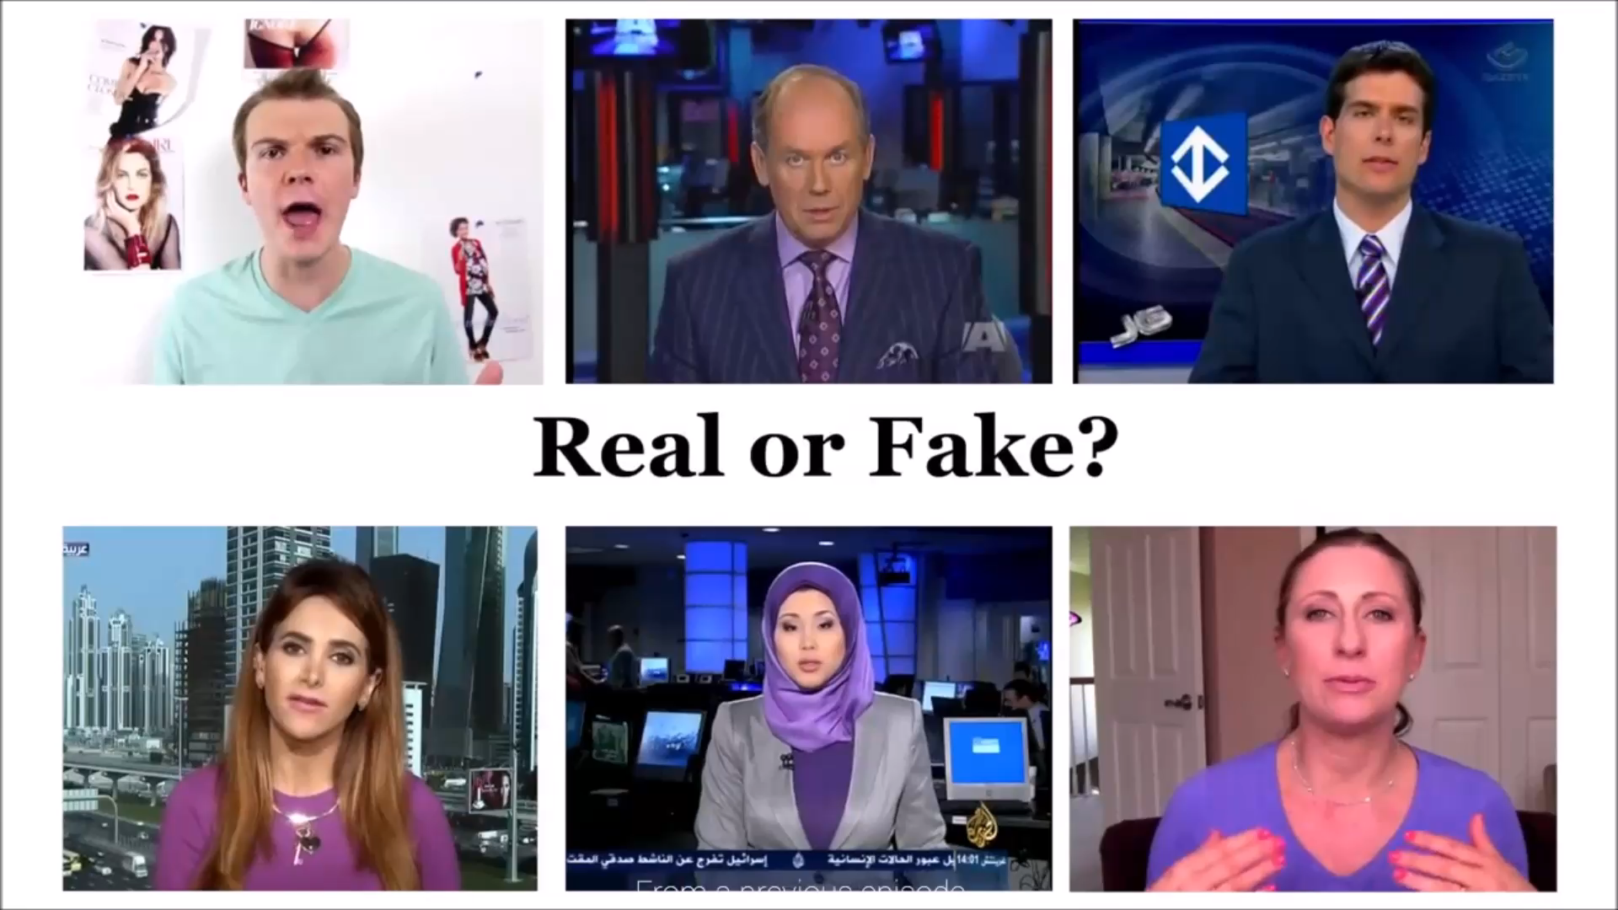
Can we detect Deep fakes with naked eyes?
Dr. N.G.P. ASC
Coimbatore, Tamil Nadu, India

Slide 7
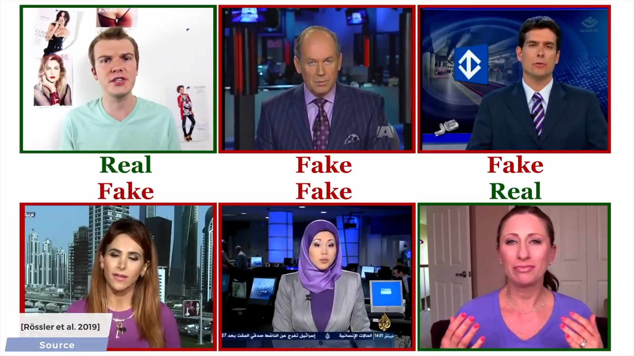
DEEPFAKE DETECTION
Dr. N.G.P. ASC
Coimbatore, Tamil Nadu, India

Slide 8
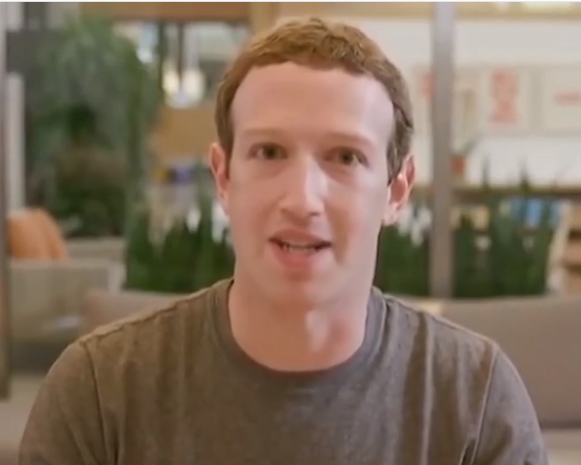
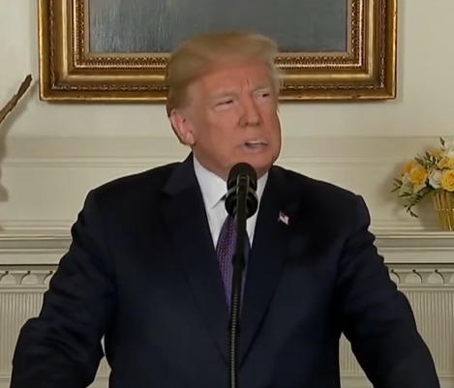
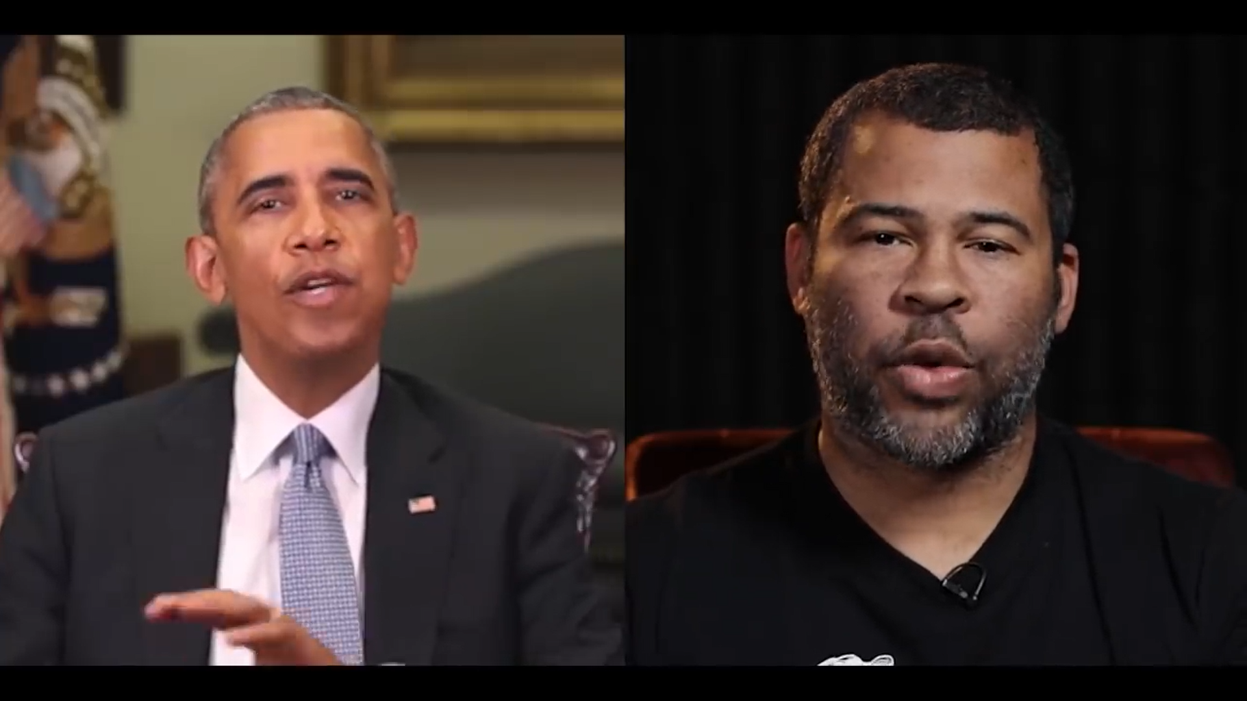
Why Deep Fake Detection ?
Fake News
Malicious hoaxes
Financial fraud
Celebrity unusual video
Revenge porn
Politician videos
Dr. N.G.P. ASC
Coimbatore, Tamil Nadu, India

Slide 9
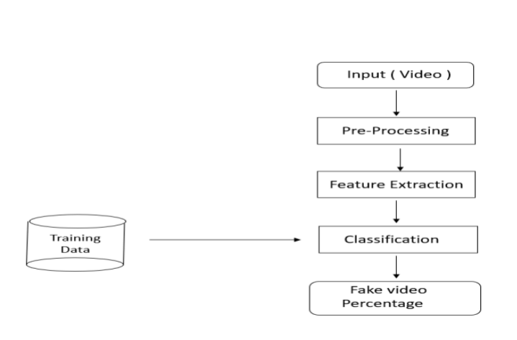
HOW IT WORKS?
Dr. N.G.P. ASC
Coimbatore, Tamil Nadu, India

Slide 10
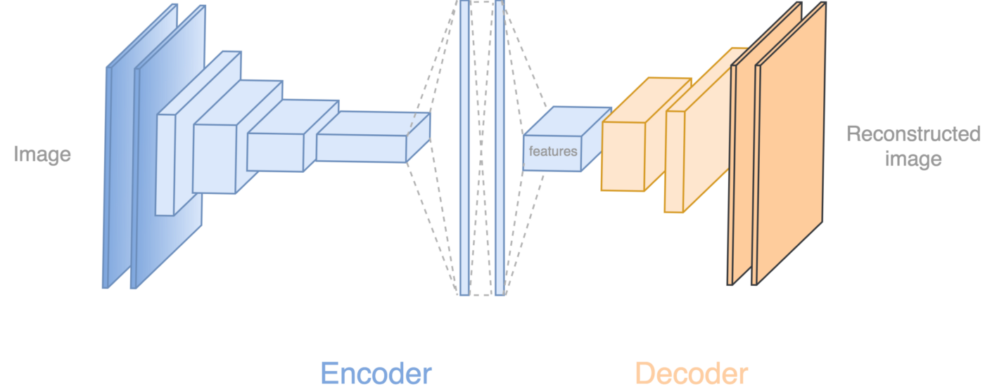
How Deep Fakes Are Created ?
Tools for deep fake creation.
Faceswap
Faceit
DeepFaceLab
DeepfakeCapsuleGAN
Large resolution facemasked
Dr. N.G.P. ASC
Coimbatore, Tamil Nadu, India

Slide 11
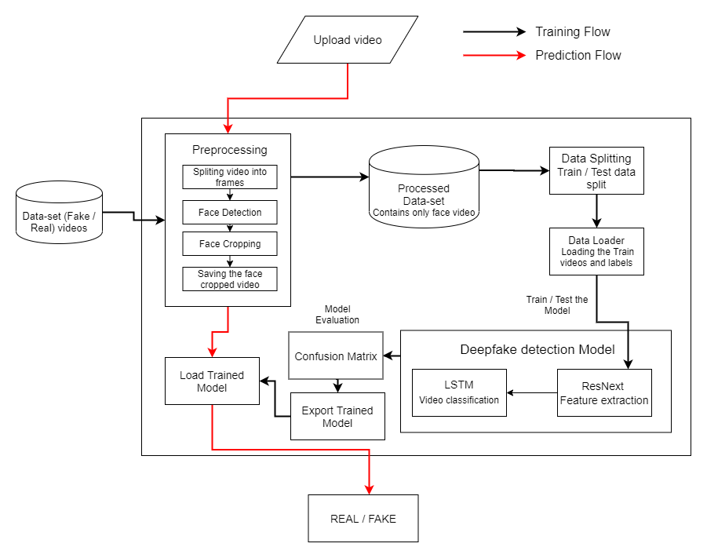
SYSTEM ARCHITECTURE
System Architecture
Dr. N.G.P. ASC
Coimbatore, Tamil Nadu, India

Slide 12
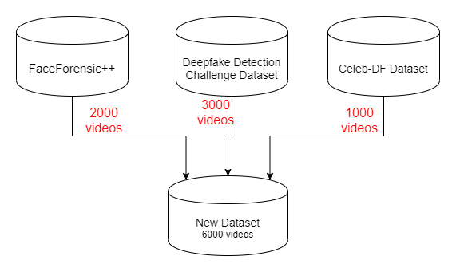
DEEPFAKE DETECTION
Data-set Exploration
Dr. N.G.P. ASC
Coimbatore, Tamil Nadu, India

Slide 13
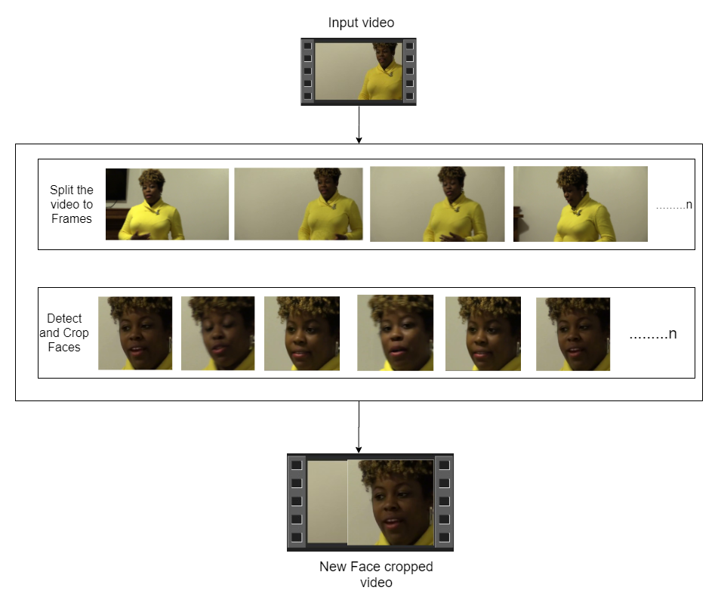

PRE-PROCESSING
Pre-processing
SPLIT VIDEO INTO FRAMES
FACE DETECTION
5
4
3
2
1
CROPING FACE
CREATING NEW FACE CROPPED VIDEO
SAVING THE FACE CROPPED VIDEO
Dr. N.G.P. ASC
Coimbatore, Tamil Nadu, India

Slide 14
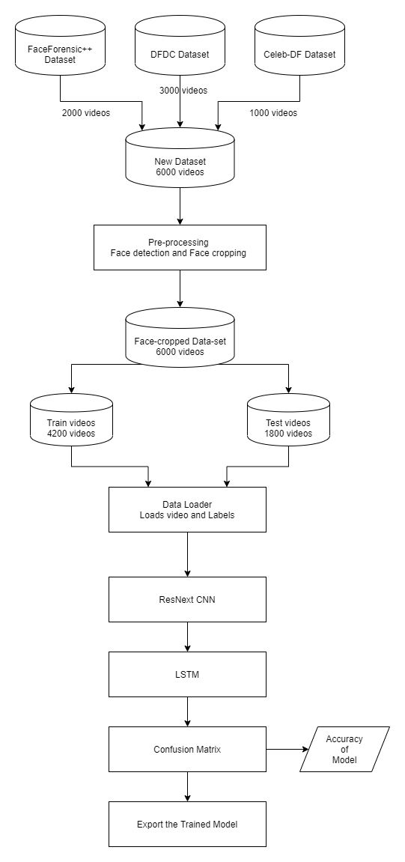
TRAINING WORKFLOW
Dr. N.G.P. ASC
Coimbatore, Tamil Nadu, India

Slide 15
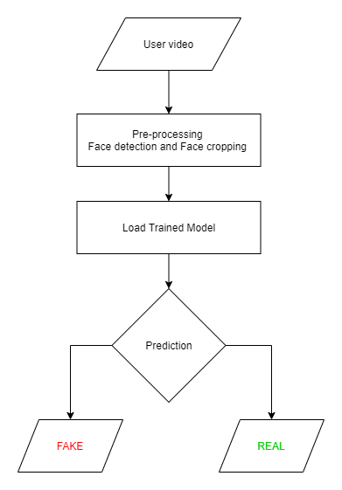
TESTING WORKFLOW
Dr. N.G.P. ASC
Coimbatore, Tamil Nadu, India

Slide 16
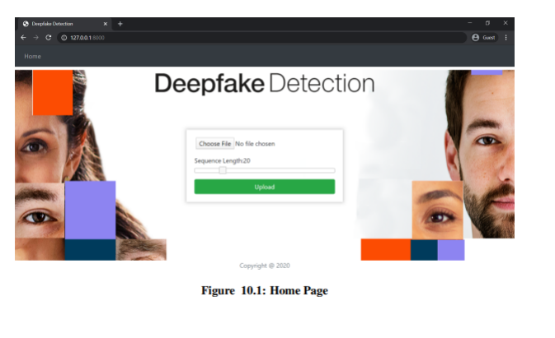
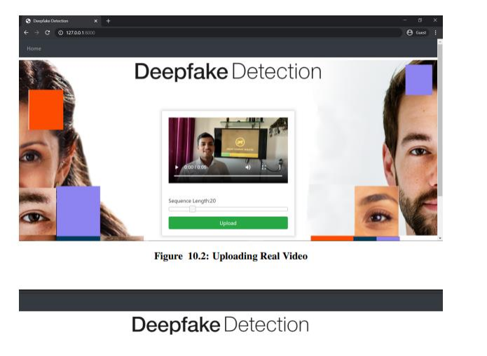
OUTPUT
Dr. N.G.P. ASC
Coimbatore, Tamil Nadu, India

Slide 17
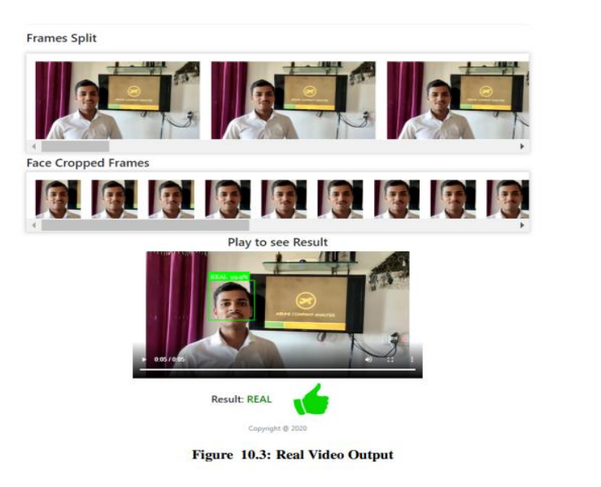
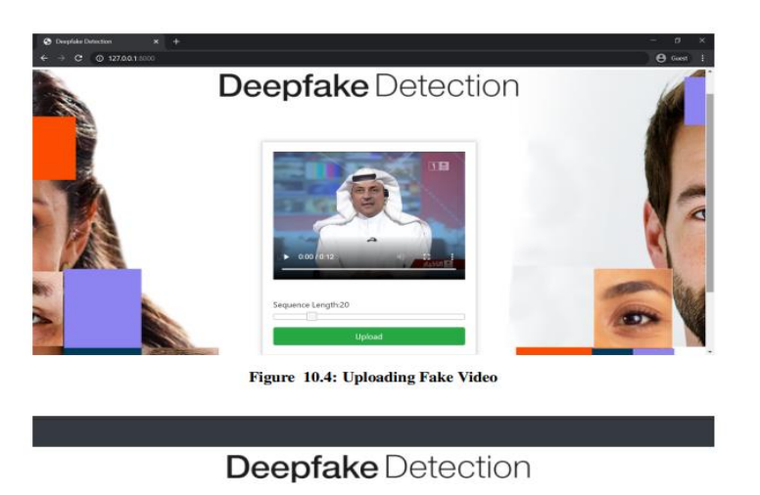
OUTPUT
Dr. N.G.P. ASC
Coimbatore, Tamil Nadu, India

Slide 18
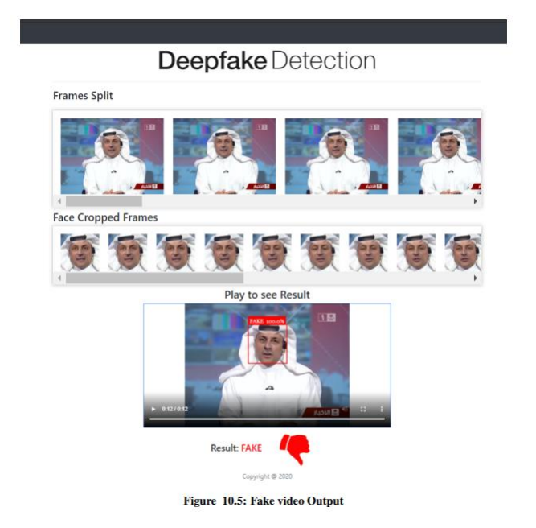
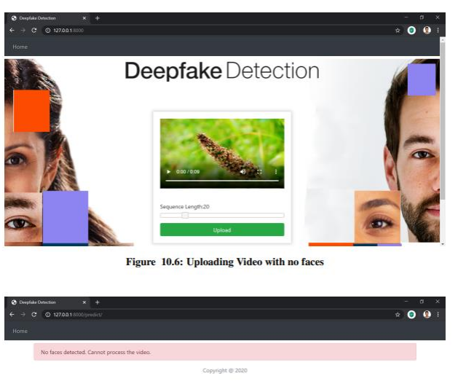
OUTPUT
Dr. N.G.P. ASC
Coimbatore, Tamil Nadu, India

Slide 19
CONCLUSION
The project addresses the pressing need to counter the rise of deepfake content in digital media.
Leveraging advanced algorithms, the system aims to stay ahead of evolving deepfake techniques.
Comprehensive datasets are utilized to train the model across a diverse range of scenarios and media types.
Real-time detection capabilities are a focal point, crucial for countering the rapid spread of manipulated content.
Emphasis on adaptability and robustness against adversarial attacks enhances the system's reliability.
The project contributes to fortifying trust in digital media by ensuring effective deepfake identification.
Overall, it plays a pivotal role in preserving the integrity and credibility of visual content in the digital era.
Dr. N.G.P. ASC
Coimbatore, Tamil Nadu, India

